Slide 1
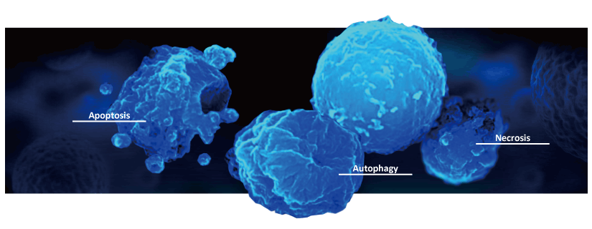
PT5050
Pathology – Cell Death, Abnormal Cell Growth,
and Cancer Movement
Dr. Liani Devito

Slide 2
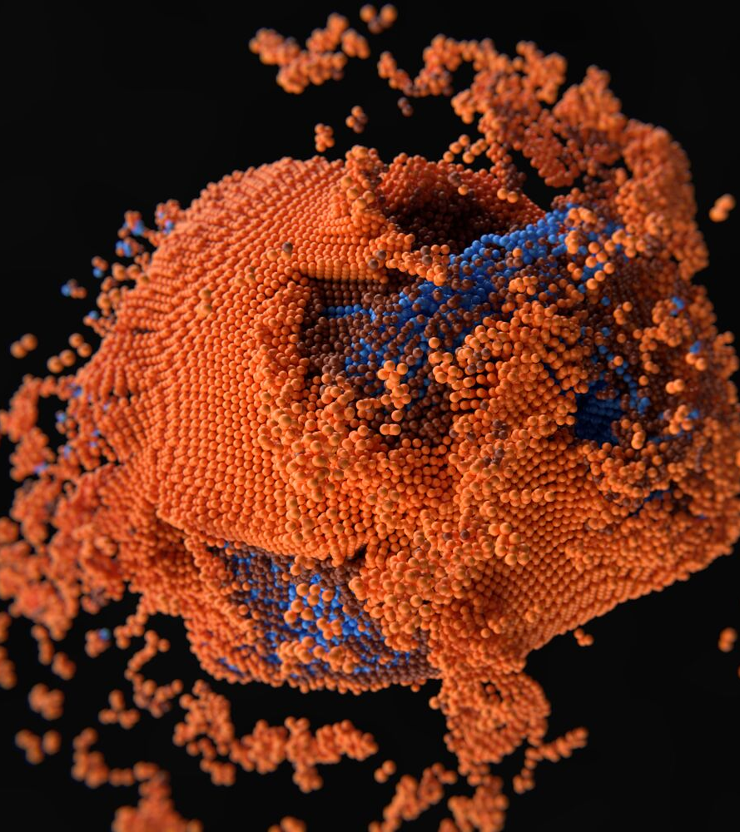
Learning Outcomes
By the end of this lecture, you should be able to:
Explain mechanisms of cell death (necrosis/ apoptosis)
Identify patterns of abnormal growth.
Understand cancer movement (invasion/metastasis)
Apply these concepts to physiotherapy practice.
This lecture explores how cells respond to injury, die, adapt, or become malignant — and why that matters in physiotherapy.

Slide 3
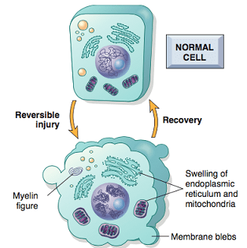
What is Cell Injury?
Cell injury occurs when a cell is exposed to stress it cannot adapt to.
It represents the earliest stage of disease — before visible tissue changes occur.
Injury can be:
  Reversible → the cell recovers when the stress is removed.
  Irreversible → the cell passes the “point of no return” and dies.
The type, duration, and intensity of the insult determine the outcome.

Slide 4
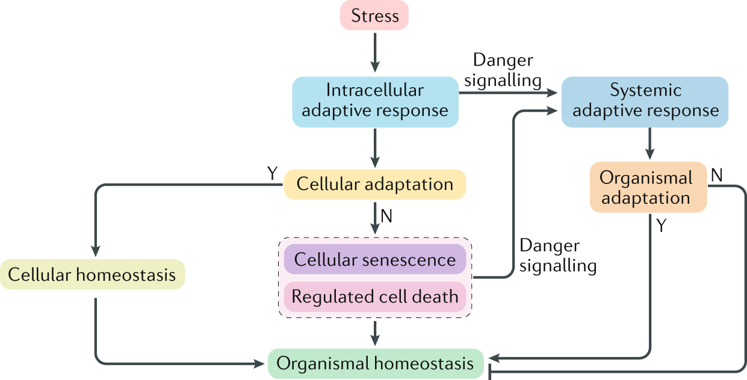
Cell response to stress
Cells respond to stress in stages:
Normal function
→ Adaptation
→ Reversible injury
→ Irreversible injury (Death)
→ Cell death (necrosis, apoptosis, or necroptosis)
Mild stress → adaptation and recovery
Persistent or severe stress → cell death (necrosis/apoptosis)
Outcome depends on the strength and duration of the insult and the cell’s capacity to adapt.
Skeletal muscle cells adapt to repeated loading (hypertrophy), but heart cells under excessive pressure eventually die (infarction).

Slide 5
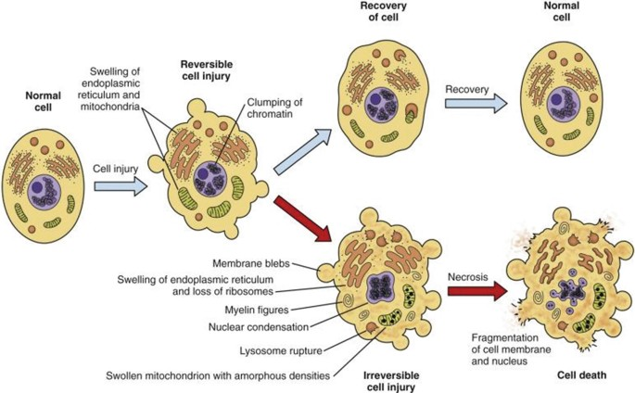
Many disease processes begin with cellular injury
The environment around cells is dynamic and constantly changing.
Cells are exposed to numerous stimuli and stresses, which may result in cell injury.

Slide 6
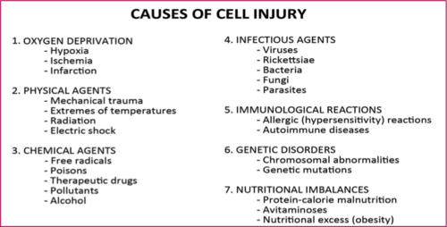
Which of these causes might physiotherapists encounter most often in their practice?

Slide 7
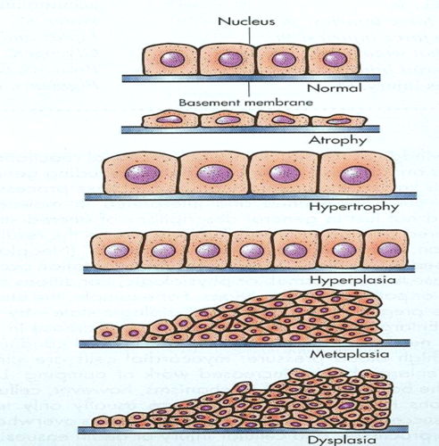
Cell Adaptation – How Cells Cope with Stress
When faced with stress, cells adjust their size, number, or type to survive.
These changes are usually reversible once the stress is removed.
Type | Description | Example
Hypertrophy | ↑ Cell size | Muscle enlargement with exercise
Hyperplasia | ↑ Cell number | Uterine lining during menstrual cycle
Atrophy | ↓ Cell size or number | Muscle wasting after immobilisation
Metaplasia | Change in cell type | Bronchial cells changing in smokers
Dysplasia | Disordered cell growth (pre-cancerous) | Cervical dysplasia from chronic irritation
Adaptation maintains function under stress — but prolonged stress can lead to dysplasia and disease.

Slide 8
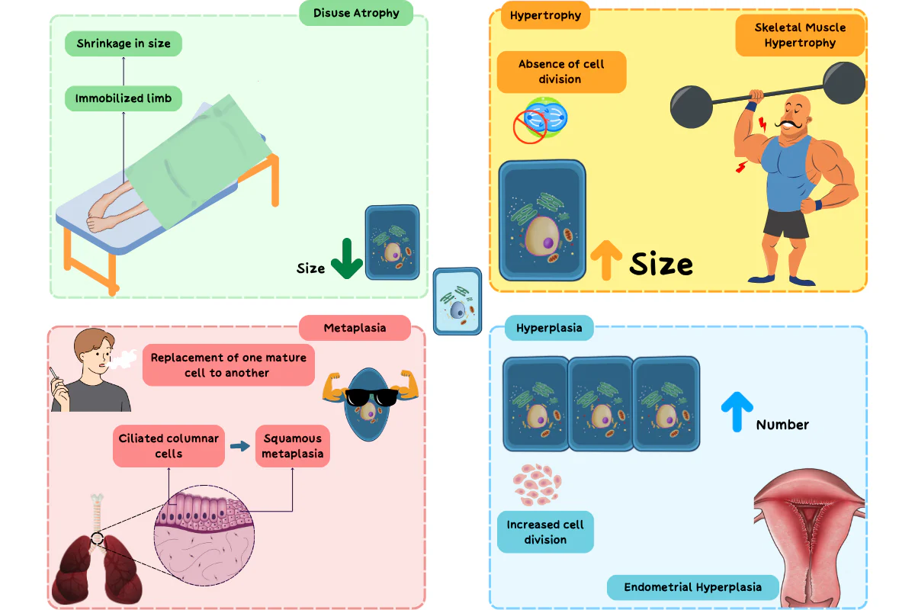
Progression of Cellular Stress Responses
Cells respond to stress — from healthy adaptation to irreversible injury and cancer. The outcome depends on the intensity, duration, and type of stress the cell experiences.
🟢 Normal Cell
↓ Physiological stress
🟡 Adaptation (e.g., hypertrophy, atrophy)
↓ Persistent or severe stress
🟠 Cell Injury
↓ Reversible → recovery or Irreversible → necrosis/apoptosis
🔴 Cell Death
↓ Uncontrolled proliferation
🟣 Abnormal Growth (Neoplasia)
↓ Invasion and spread
⚫ Cancer & Metastasis

Slide 9
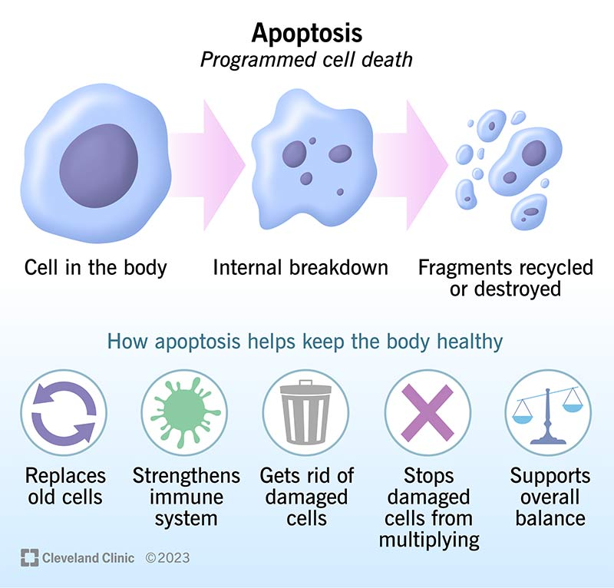
Is Cell Death Always Bad?
Is cell death always harmful — or can it be useful?
Not all cell death is the same — some is programmed
Healthy cell death (Apoptosis):
normal turnover of gut and skin cells
Fun fact: During embryonic development, apoptosis removes cells between the fingers and toes, allowing separate digits to form — a beautiful example of cell death with purpose!

Slide 10
Reversible vs Irreversible Cell Injury
Feature | Reversible Injury | Irreversible Injury
Definition | Early damage that can be repaired if the stress is removed | Permanent damage leading to cell death
Cell Morphology | Cell swelling, fatty change, chromatin clumping | Membrane rupture, nuclear fragmentation, lysed organelles
Mitochondria | Mild swelling, function restored if oxygen returns | Severe swelling, rupture → no ATP recovery
Plasma Membrane | Intact or slightly damaged | Irreversibly damaged → leakage of contents
Outcome | Recovery and normal function | Necrosis or apoptosis (cell death)
Whether a cell recovers or dies depends on:
Severity and duration of the injury
Type of cell and its ability to regenerate
Availability of oxygen and nutrients

Slide 11
Stage | Key Morphological Features | Interpretation
Normal Cell | Normal size and shape; clear cytoplasm; intact organelles | Homeostasis maintained
Reversible Injury | - Cell swelling (hydropic change) - Fatty change (especially in the liver and heart) - Mitochondrial swelling - Chromatin clumping (mild) | Early stress; cell can recover if cause is removed
Irreversible Injury | - Membrane rupture- Lysosome leakage- - Severe mitochondrial damage -Nuclear changes: pyknosis → karyorrhexis → karyolysis | Point of no return → cell death (necrosis/apoptosis)
Morphological Changes in Cell Injury

Slide 12
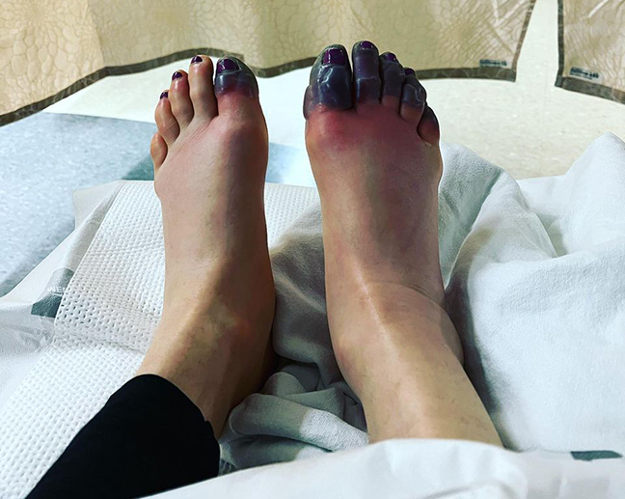
Necrosis – Uncontrolled Cell Death
Necrosis is the uncontrolled, premature death of cells in living tissue.
It results from severe or irreversible injury and is always pathological.
Key Characteristics:
Loss of membrane integrity → leakage of cell contents
Triggers inflammation in the surrounding tissue
Energy-independent process (no ATP required)
Affects groups of cells, not single cells
Common causes: ischemia, trauma, toxins, infection
Necrosis = “messy death” — the cell bursts, spills its contents, and inflames nearby tissue.

Slide 13
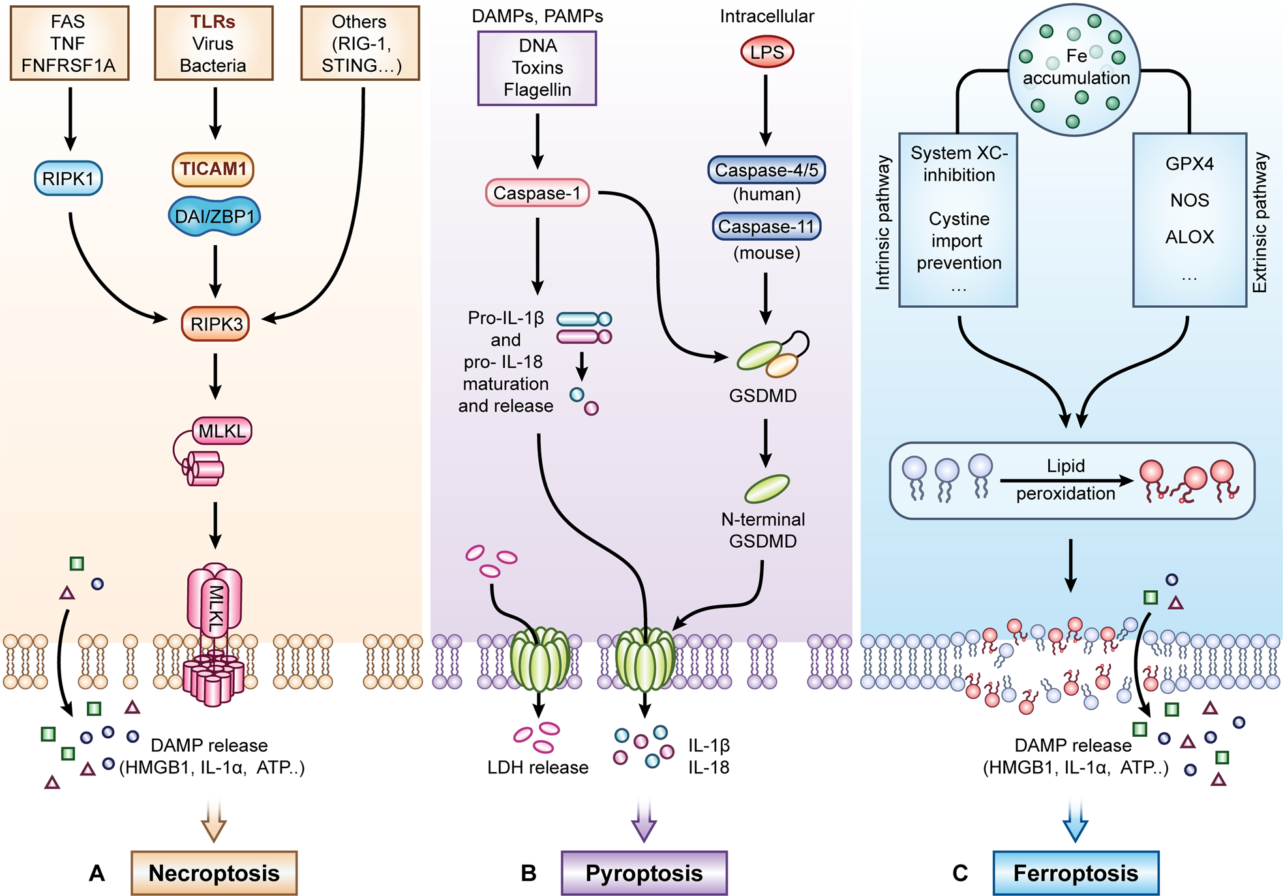
Molecular Control
of Necrosis
Traditionally, necrosis was considered a purely accidental or uncontrolled process caused by severe injury (e.g. trauma, toxins, ischemia).
Type of Cell Death | Trigger / Cause | Key Molecular Players | Outcome / Features
Classical Necrosis | Severe ischemia, trauma, toxins | None (unregulated) → ion pump failure, lysosomal enzyme release | Accidental cell rupture; tissue inflammation and scarring
Necroptosis | Death receptor activation (e.g. TNF) when caspases are inhibited | RIPK1, RIPK3, MLKL | Programmed necrosis; cell swelling and rupture via MLKL pore formation
Ferroptosis | Iron overload + oxidative stress (ROS accumulation) | Fe²⁺, GPX4 inhibition, lipid peroxidation enzymes | Iron-dependent lipid damage → membrane rupture; seen in ischemia-reperfusion injury
Pyroptosis | Infection, immune activation, inflammasome signaling | Caspase-1, Gasdermin D, IL-1β, IL-18 | Inflammatory death; membrane pore formation → cell lysis and cytokine release

Slide 14
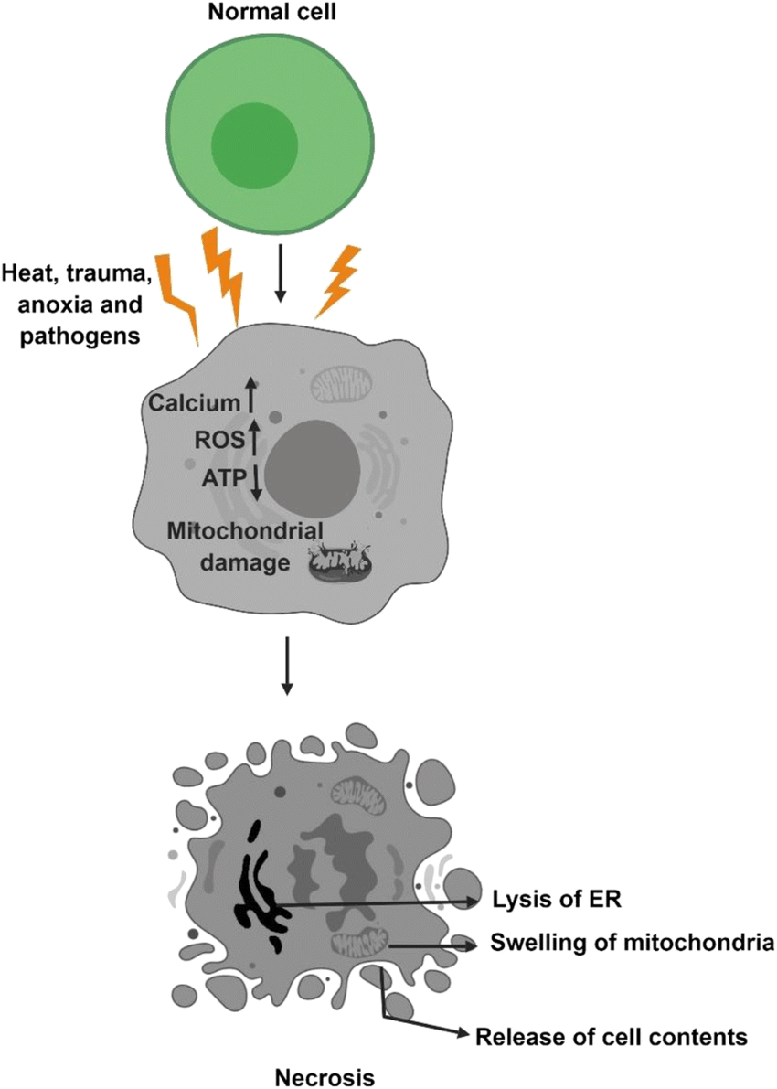
Types of Necrosis
Different types of necrosis reflect the cause of injury and the tissue involved.
Each type has a characteristic microscopic appearance and clinical relevance.
Type of Necrosis | Description / Appearance | Typical Location / Example
Coagulative | Tissue architecture preserved; cells appear “ghost-like” | Most solid organs (esp. heart, kidney) after ischemia
Liquefactive | Tissue becomes soft, liquid; due to enzyme digestion | Brain infarcts, abscesses
Caseous | “Cheesy,” crumbly appearance; mix of dead cells and debris | Tuberculosis (TB) granulomas
Fat | Chalky white deposits (saponification of fats with calcium) | Pancreatitis, trauma to fat tissue
Fibrinoid | Immune-mediated; deposition of immune complexes in vessel walls | Vasculitis, hypertension-related vessel injury

Slide 15
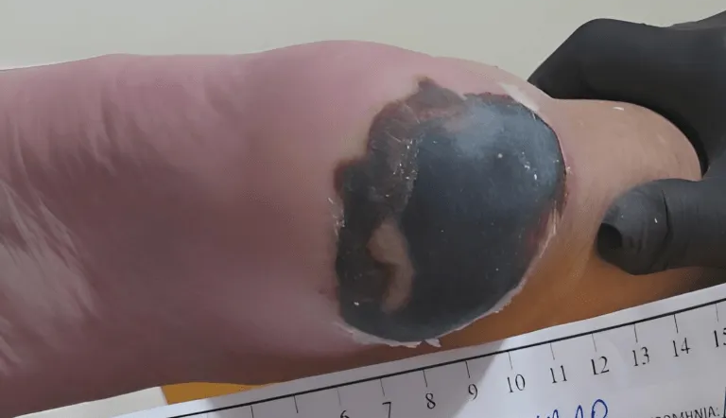
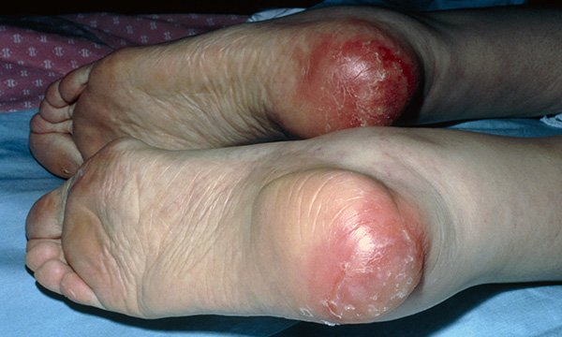
Necrosis in Physiotherapy Practice
Case Scenario:
A 72-year-old woman develops a pressure ulcer on her heel after a prolonged hospital stay. The wound shows black, dry tissue (eschar) and surrounding inflammation.
Question:
What type of cell injury has occurred, and how does this affect physiotherapy management?

Slide 16
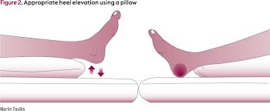
Key Pathological Process:
Prolonged ischemia → coagulative necrosis of skin and subcutaneous tissue
Loss of blood supply prevents oxygen delivery → ATP depletion → cell membrane rupture
Inflammation and tissue breakdown → formation of fibrotic scar after healing
Physiotherapy Implications:
Avoid direct pressure or friction on necrotic areas
Promote offloading and repositioning to restore perfusion
Collaborate with the wound care team for debridement and healing
Monitor for infection (liquefactive necrosis risk if bacteria invade)
Rehabilitation goal: Maintain joint mobility and circulation in unaffected areas to prevent further injury

Slide 17
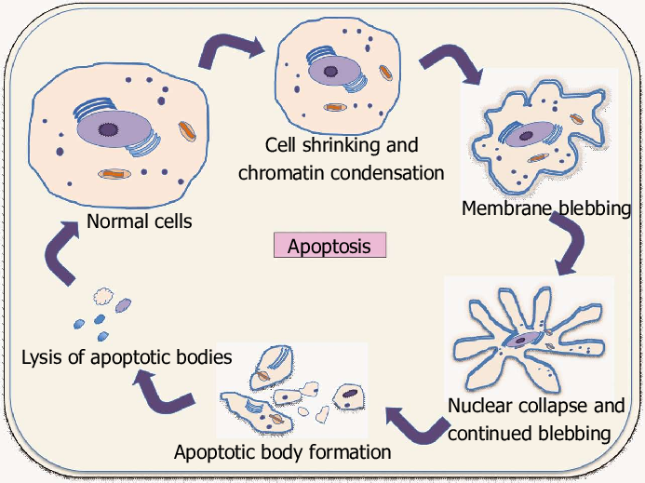
Apoptosis – Programmed Cell Death (“Good Death”)
Apoptosis is a regulated, energy-dependent process in which cells die without causing inflammation.
It removes unwanted, damaged, or aged cells in a tidy, physiological way.
Key Features:
Controlled process – initiated by specific cellular signals
Requires ATP – active, energy-dependent
Cell shrinks and fragments into apoptotic bodies
Membrane remains intact → no leakage
No inflammation – cell contents safely phagocytosed
Can be physiological or pathological
Apoptosis = a built-in cellular “self-destruct” mechanism that maintains tissue health and prevents inflammation.

Slide 18
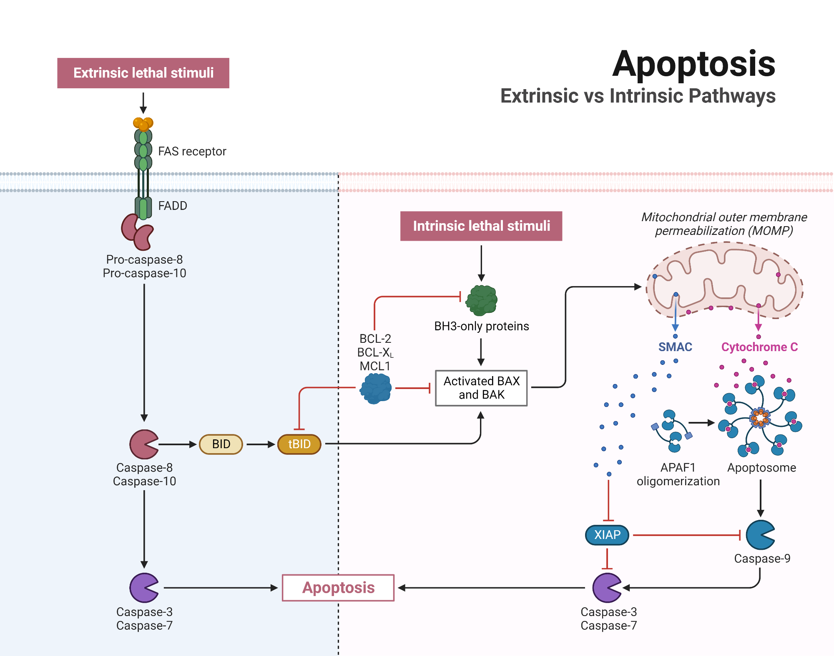
Molecular Control
of Apoptosis
Intrinsic: internal damage → mitochondria → caspase-9 → apoptosis
Extrinsic: external death ligands → receptor → caspase-8 → apoptosis
Both end in activation of executioner caspases → cell death
Apoptosis is tightly regulated by caspases — enzymes that break down cell components in an orderly way.
Two main pathways can trigger it:
Intrinsic (mitochondrial) pathway:
Damage inside the cell (e.g. DNA damage, stress) causes mitochondria to release cytochrome c, which activates caspases.
Extrinsic (receptor) pathway:
Signals from outside the cell (e.g. death ligands binding to death receptors) activate caspases through the cell membrane.
Both pathways lead to controlled cell dismantling without inflammation.

Slide 19
Physiological vs Pathological Apoptosis
Type | Description | Examples | Outcome
Physiological Apoptosis | Normal, healthy cell death that maintains tissue balance | - Menstrual cycle: shedding of endometrial lining - Immune system: removal of excess or self-reactive lymphocytes – Embryonic development: separation of fingers and toes | Maintains tissue homeostasis, shapes organs, prevents autoimmunity
Pathological Apoptosis | Abnormal or excessive cell death triggered by disease or injury | - Viral infections (e.g., hepatitis → liver cell apoptosis) - DNA damage from radiation or chemotherapy - Neurodegenerative diseases (e.g., Alzheimer’s, Parkinson’s) | Contributes to tissue atrophy or organ dysfunction

Slide 20
Apoptosis vs Necrosis
Feature | Apoptosis (“Clean Death”) | Necrosis (“Messy Death”)
Type of process | Controlled, programmed (regulated) | Uncontrolled, accidental
Energy (ATP) | Requires energy (active) | Energy failure (passive)
Cause | Normal development, DNA damage, stress | Severe injury, toxins, ischemia
Cell size | Shrinks (condensation) | Swells (oncosis)
Membrane integrity | Intact until the end | Ruptures early → leakage
Inflammation | None | Strong
Cells affected | Individual cells | Groups of cells
Nucleus | Condenses → fragments neatly | Swells → disintegrates
Outcome | Clean removal by phagocytes, no scarring | Tissue damage, fibrosis, scarring

Slide 21
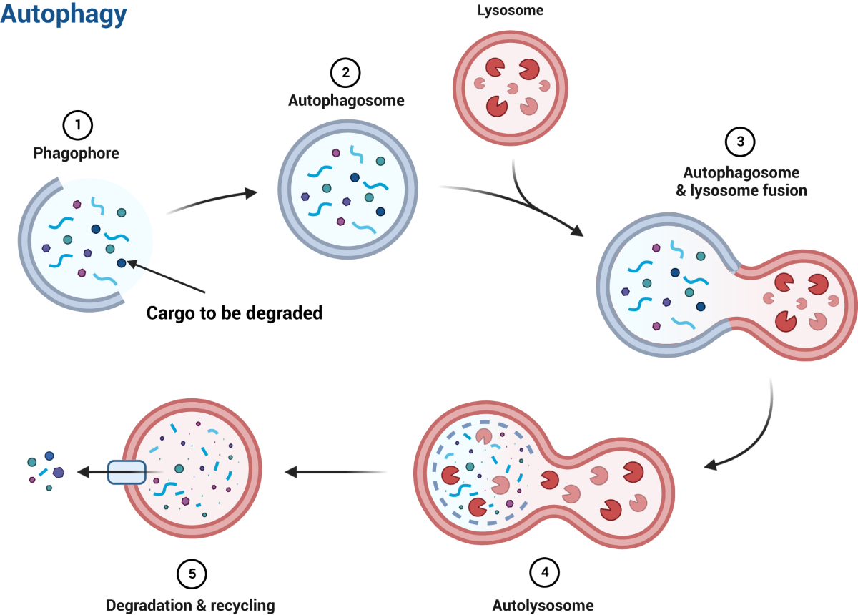
Autophagy – The Cell’s Recycling System
Autophagy (from Greek “auto” = self, “phagy” = eating) is a cellular recycling process that breaks down and reuses damaged organelles and proteins to maintain energy and survival during stress.
Key Points:
Lysosomes digest unwanted or damaged components.
Triggered by nutrient deprivation, stress, or ageing.
Helps cells survive mild stress by cleaning and renewing themselves.
If excessive → may lead to cell death.
Examples:
Active during fasting, exercise, or low oxygen conditions.
Helps remove damaged mitochondria (“mitophagy”).
It is important in muscle maintenance and in preventing degeneration.

Slide 22
Why Understanding Cell Death Matters in Physiotherapy
Pathological Process | Effect on Tissue | Physiotherapy Implication
Reversible injury | Temporary dysfunction, swelling | Early movement & gentle exercise enhance recovery
Apoptosis | Controlled removal → regeneration | Supports tissue remodelling post-exercise or injury
Autophagy | Recycling → cell survival | Triggered by exercise and metabolic stress; aids recovery
Necrosis | Inflammation, fibrosis, scarring | Avoid load on necrotic/healing tissue; prevent further damage
Chronic cell injury | Fibrosis, atrophy, dysfunction | Long-term rehabilitation to restore or compensate function
Cell injury and death determine how tissues heal, adapt, and respond to rehabilitation.
Physiotherapists use this knowledge to design safe, effective treatment plans based on tissue biology.

Slide 23
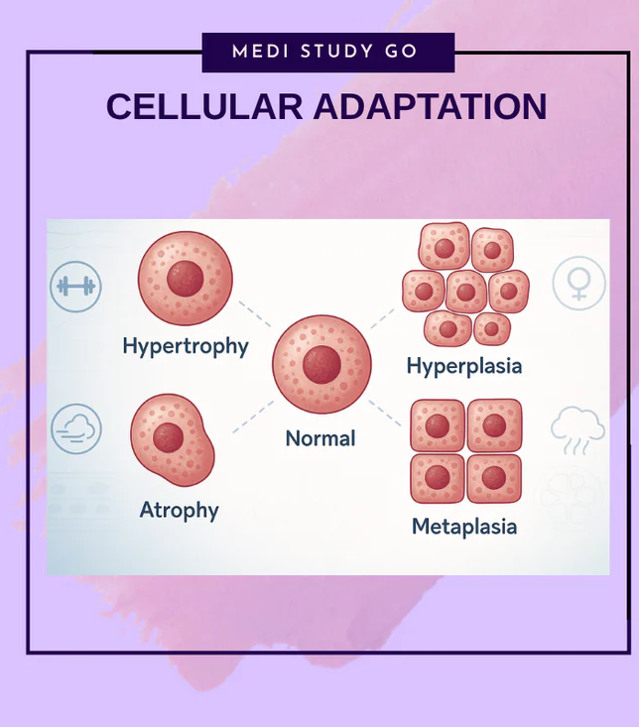
Relevance for Physiotherapy
Exercise causes controlled cellular stress — this is how adaptation happens. However, when the stress exceeds the tissue’s recovery capacity, it becomes pathological.
Type of Muscle Damage | Cause | Cellular Response | Physiotherapy Implication
🟢 Exercise-induced (Physiological) | Controlled overload during training | Mild, reversible cell injury → activates apoptosis and autophagy for repair | Gradual progressive loading enhances strength and recovery
🔴 Pathological Damage | Excessive load, poor recovery, ischemia, toxins | Necrosis → inflammation, fibrosis, tissue loss | Reduce intensity, ensure adequate rest, monitor for pain and swelling
Balance = Load + Recovery

Slide 24
Stage | Trigger | Cellular Response | Outcome
Normal | Homeostasis | Normal structure & function | Health
Adaptation | Increased demand, mild stress | Hypertrophy, hyperplasia, atrophy, metaplasia | Reversible compensation
Reversible Injury | Persistent stress, mild oxygen lack | Swelling, fatty change | Recovery possible
Irreversible Injury | Severe stress, toxins, ischemia | Membrane & mitochondrial damage | Cell death
Apoptosis | Programmed, controlled | Caspase activation | Clean removal
Necrosis & others | Uncontrolled damage | Membrane rupture, inflammation | Tissue destruction
Recap – From Injury to Death

Slide 25

Which of the following best describes apoptosis?
A. Accidental cell death caused by severe injury
B. Controlled, energy-dependent cell death without inflammation
C. Cell swelling and rupture with inflammation
D. Uncontrolled necrosis during infection

Slide 26

Which change is an example of cell adaptation?
A. Muscle atrophy after immobilisation
B. Cell rupture after trauma
C. DNA fragmentation in apoptosis
D. Fatty degeneration in the liver

Slide 27

What happens when a cell’s stress is too severe or prolonged?
A. The cell repairs completely
B. The cell becomes stronger
C. The injury becomes irreversible and leads to death
D. The cell divides more rapidly

Slide 28

What is the main difference between necrosis and apoptosis?
A. Only apoptosis uses ATP
B. Only necrosis happens in single cells
C. Necrosis is reversible
D. Apoptosis always causes inflammation

Slide 29

What is the role of autophagy?
Causes inflammation
B. Recycles damaged components to help the cell survive
C. Induces fibrosis
D. Triggers necrosis

Slide 30

Why does this topic matter in physiotherapy?
A. To identify infections
B. To predict how tissues heal or scar
C. To measure DNA damage
D. To prevent apoptosis

Slide 31
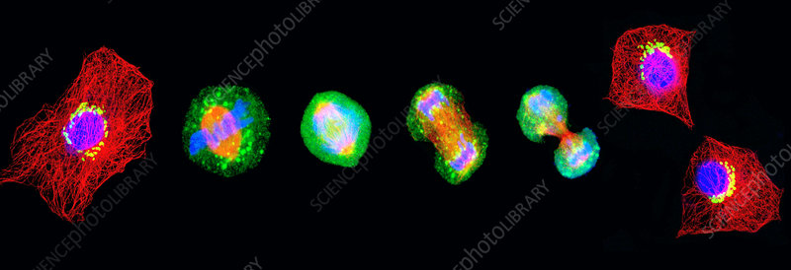
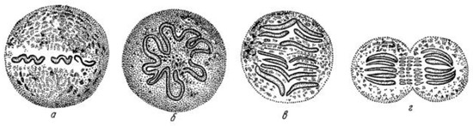
From Adaptation to Loss of Control
Cells can adapt to survive stress…
But when growth regulation is lost, abnormal cell growth begins — The first step toward tumour formation and cancer.
A single dividing cell can give rise to billions of descendants — if control systems fail, that’s how tumours start.

Slide 32
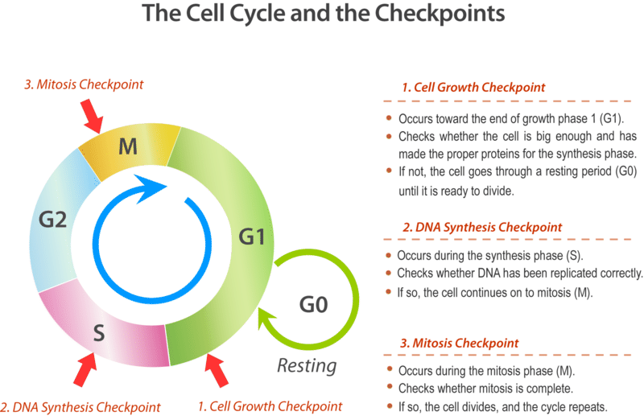
Healthy cells follow a regulated cycle — cancer cells break these rules.

Slide 33
Types of Abnormal Cell Growth
Type | Definition | Example | Physiological vs Pathological | Relevance / Note
Hypertrophy | ↑ in cell size (no new cells) | Skeletal muscle after resistance training | 🟢 Physiological: exercise 🔴 Pathological: cardiac hypertrophy in hypertension | Reversible; occurs in non-dividing cells (muscle)
Hyperplasia | ↑ in cell number | Endometrial thickening during the menstrual cycle | 🟢 Physiological: hormonal 🔴 Pathological: endometrial hyperplasia | Controlled by hormones/growth factors; can precede dysplasia
Atrophy | ↓ in cell size or number | Muscle wasting after immobilisation | 🔴 Pathological but reversible with activity | Physiotherapy link: early mobilisation restores function
Metaplasia | Replacement of one cell type with another | Bronchial ciliated epithelium → squamous in smokers | 🔶 Adaptive but risky if prolonged | Reversible if stimulus removed; chronic stress may → dysplasia
Dysplasia | Disordered growth of cells | Cervical epithelium in HPV infection | 🔴 Pre-malignant | Loss of uniformity, abnormal nuclei; may progress to cancer

Slide 34
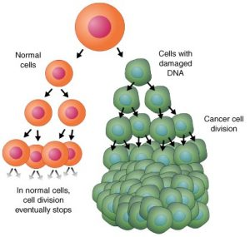
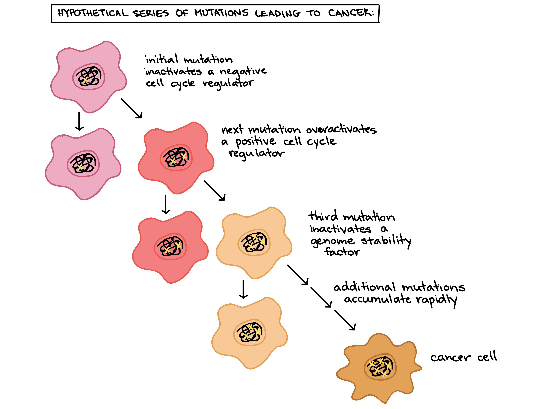
Neoplasia – When Growth Becomes Uncontrolled
Neoplasia (from Greek “neo” = new, “plasis” = growth) is the autonomous, unregulated proliferation of cells that persists even after the original stimulus is removed.

Slide 35
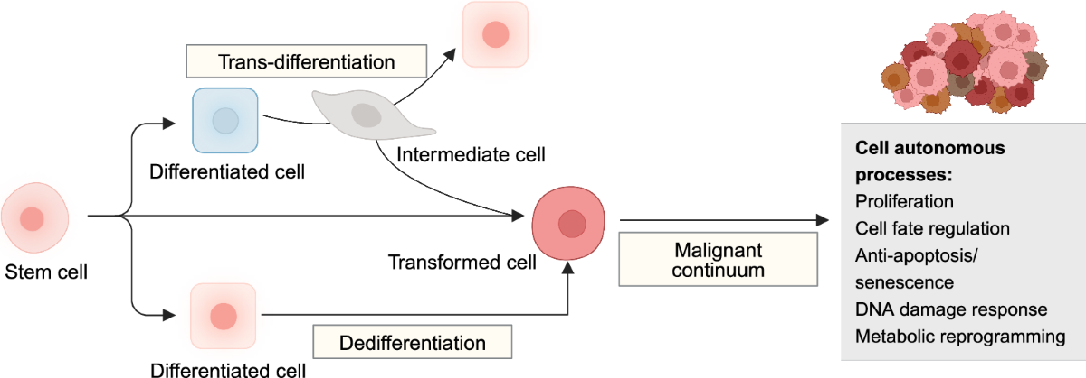
Neoplasia Key Features:
Growth is independent of normal controls (e.g., growth factors, checkpoints).
Cells divide continuously, ignoring regulatory signals.
Forms a mass of abnormal tissue — called a neoplasm or tumour.
It can be benign (localised) or malignant (invasive and metastatic).
Often arises from dysplasia — the “point of no return” in abnormal growth.

Slide 36
Tumour Characteristics – When Cells Go Rogue
Feature | Description | Molecular / Cellular Mechanism | Analogy / Key Idea
Autonomy – Self-Sufficient Growth | Tumour cells no longer depend on external growth signals; they keep dividing even without stimulation. | - Activation of oncogenes (growth drivers)- Loss of tumour suppressor genes (p53, Rb) → no “brakes” on cell cycle | “They make their own rules.”
Invasiveness – No Respect for Boundaries | Tumour cells lose contact inhibition and spread into nearby tissues. | - Loss of cell adhesion molecules- Secretion of proteases that degrade the extracellular matrix | “They push, invade, and spread.”
Loss of Control – Abnormal Differentiation & Immortality | Cells lose normal structure and function (anaplasia) and evade death. | - Activation of telomerase (infinite division)- Apoptosis pathways switched off | “They forget who they are — and never stop.”

Slide 37
Feature | Benign Tumour | Malignant Tumour (Cancer)
Growth rate | Slow, limited, may stop | Rapid, uncontrolled
Growth pattern | Localised, often encapsulated | Invasive, infiltrates surrounding tissue
Cell differentiation | Well-differentiated; resembles normal tissue | Poorly differentiated (anaplasia)
Mitotic activity | Low, normal mitoses | High, abnormal mitoses
Invasion | No invasion; stays where it started | Invades nearby tissues
Metastasis | Absent | Present (via blood or lymph)
Effect on host | Minimal (unless compressing organs) | Severe; tissue destruction, cachexia
Recurrence after removal | Rare | Common
Example | Uterine fibroid, skin papilloma | Carcinoma, sarcoma, melanoma
Benign vs Malignant Tumours

Slide 38
Molecular Basis of Cancer – The Balance Lost
Cancer develops when the balance between cell growth and cell death is lost due to genetic mutations in key regulatory genes.
Gene Type | Normal Function | When Mutated… | Example | Analogy
Oncogenes | Promote normal cell growth and division (as proto-oncogenes) | Become overactive → cells divide uncontrollably | RAS, MYC, HER2 | Gas pedal stuck on
Tumour Suppressor Genes | Stop cell cycle or trigger apoptosis when DNA is damaged | Become inactivated or deleted→ no “brakes” | p53, Rb, APC | Brakes fail
DNA Repair Genes | Fix mutations during replication | Mutation = genetic instability→ more errors | BRCA1/2, MLH1 | Mechanic missing
p53: “Guardian of the Genome”
Detects DNA damage and halts cell division for repair.
p53 mutations are found in >50% of human cancers.

Slide 39
Hallmarks of Cancer – The Six Core Behaviours
Cancer cells share a set of biological capabilities that allow them to grow, survive, and spread — known as the Hallmarks of Cancer (Hanahan & Weinberg, 2000; updated 2011).
Hallmark | Description | Example / Mechanism | Icon / Visual Cue
Sustaining proliferative signalling | Continuous self-signalling for growth | Overactive RAS, HER2 | Gas pedal stuck on
Evading growth suppressors | Ignore stop signals (e.g. p53, Rb loss) | Mutated p53, RB1 | Broken brakes
Resisting cell death | Avoid apoptosis despite DNA damage | Overexpression of Bcl-2 | Refuse to die
Enabling replicative immortality | Activate telomerase to keep dividing | Infinite cell divisions | Endless life
Inducing angiogenesis | Stimulate new blood vessel growth | Release VEGF | New blood supply
Activating invasion & metastasis | Invade tissues, spread via blood/lymph | Loss of adhesion (E-cadherin) | Spreading footprint

Slide 40
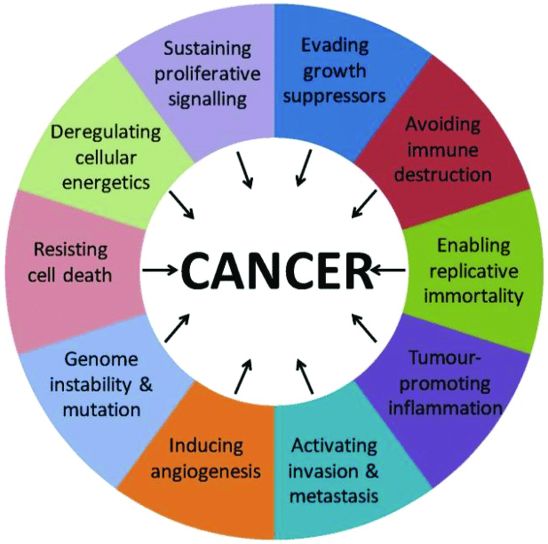
In 2011, Hanahan & Weinberg added four more:
  1. Deregulating cellular energetics (altered metabolism)
  2. Avoiding immune destruction
  3. Genome instability & mutation
  4. Tumour-promoting inflammation

Slide 41
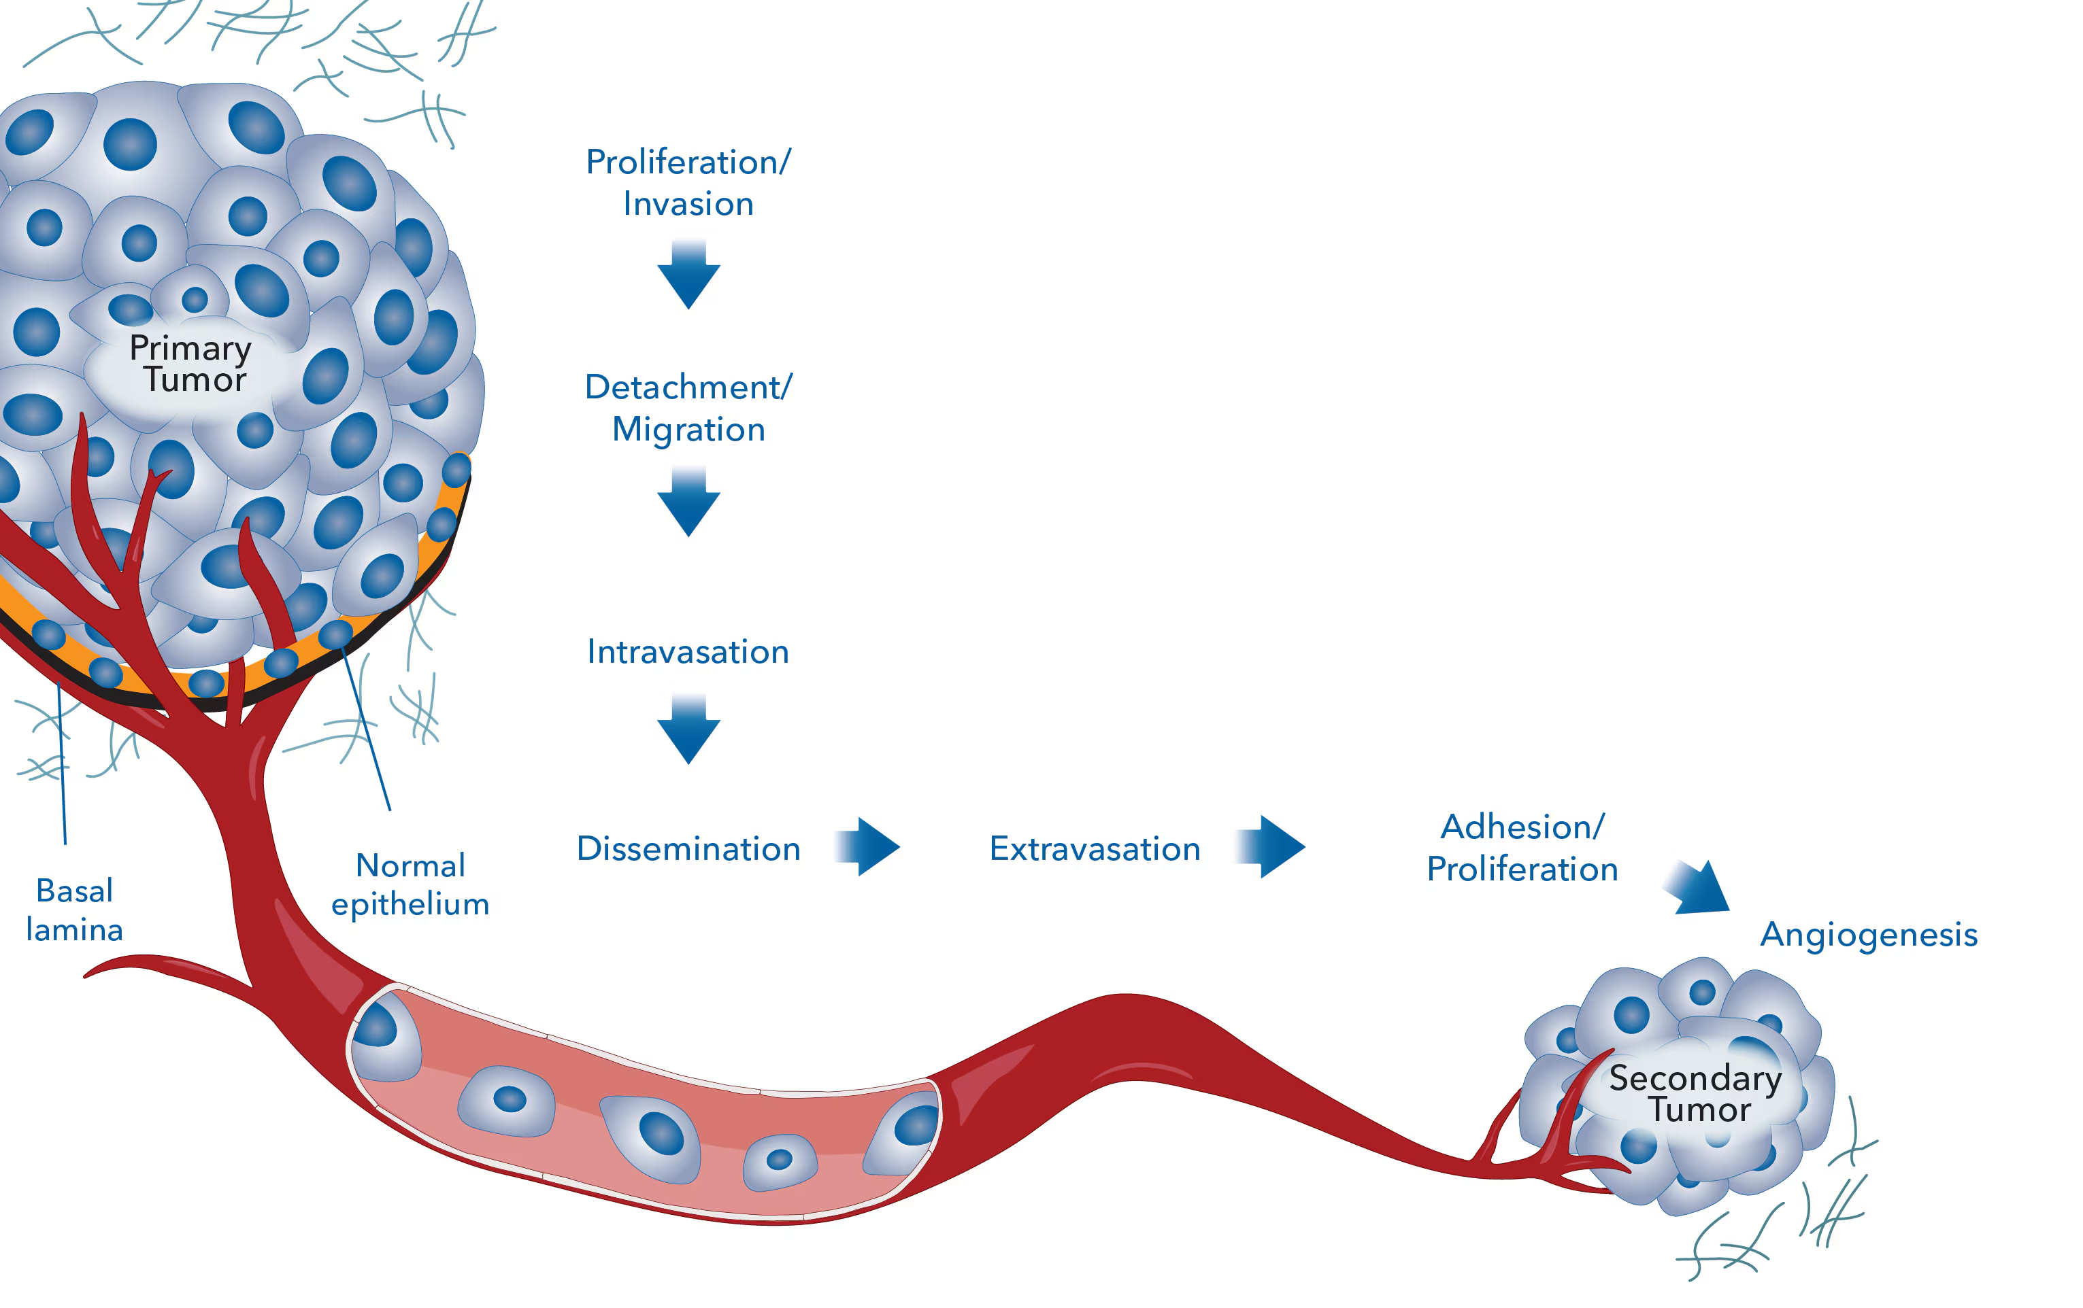
Metastasis – The Movement of Cancer Cells
Metastasis is the process by which cancer cells spread from their original site to form secondary tumours in distant organs.
Steps of Metastasis – Overview
Step | Process | Description | Visual Cue
Detachment | Loss of cell-to-cell adhesion | ↓ E-cadherin allows cells to separate from the primary tumour | Breaking ties
Invasion | Penetration of basement membrane and extracellular matrix | Tumour cells secrete proteases(collagenases, MMPs) | Breaking barriers
Intravasation | Entry into blood or lymphatic vessels | Cancer cells migrate through vessel walls | Entering the stream
Circulation | Survival in bloodstream or lymph | Cells resist immune attack and shear stress; may form emboli | Travelling cells
Extravasation | Exit from circulation into new tissue | Attach to endothelium → squeeze out into target organ | Exiting vessels
Colonisation | Growth and angiogenesis at new site | Cells adapt to new environment → form secondary tumour | New growth

Slide 42
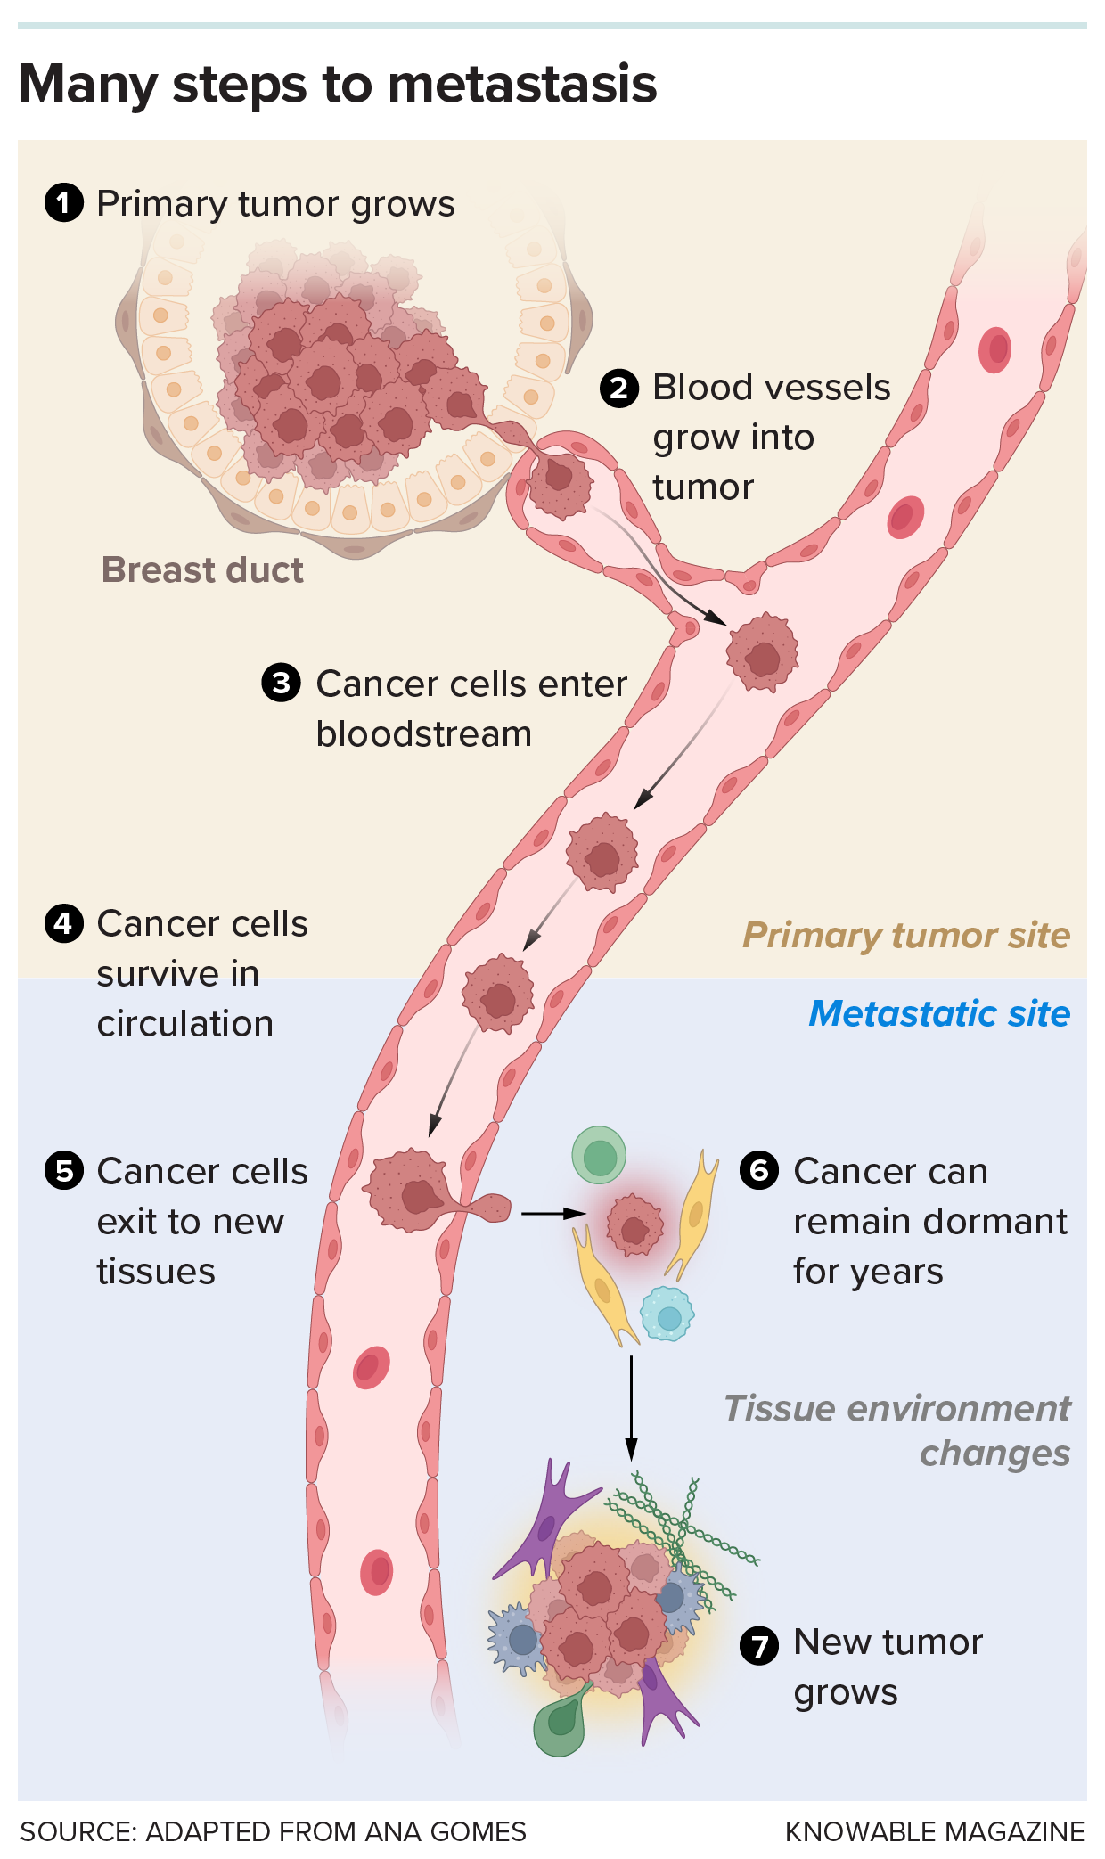
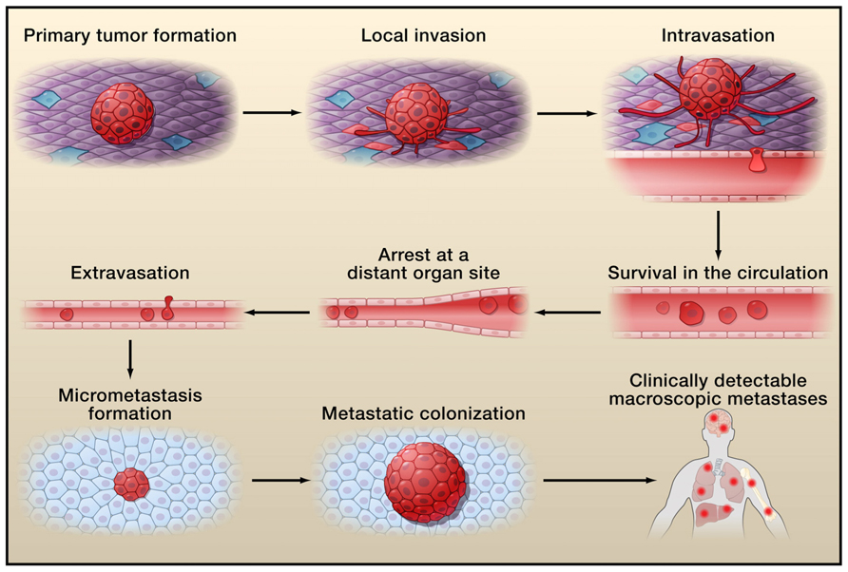

Slide 43
Routes of Metastatic Spread
Cancer cells travel through different routes to reach distant organs.
Each cancer type has a preferred pathway based on its tissue of origin.
Route of Spread | Mechanism / Pathway | Common Cancers / Examples | Visual Cue
Lymphatic spread | Cells enter lymphatic vessels, move to lymph nodes, then bloodstream. | Most carcinomas (e.g. breast, lung). | Network of green lymph vessels → nodes.
Haematogenous spread | Cells invade blood vessels (usually veins). | Sarcomas, also liver & lung metastases common. | Blood vessel with circulating tumour cells.
Transcoelomic spread | Cancer cells spread across body cavities(pleural, peritoneal, pericardial). | Ovarian, stomach, coloncancers. | Floating cells in a body cavity.
Direct seeding / local invasion | Tumour extends into adjacent tissues by direct contact. | Colorectal → bladder, lung → chest wall. | Tumour roots growing into neighbouring tissue.

Slide 44
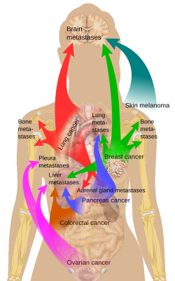
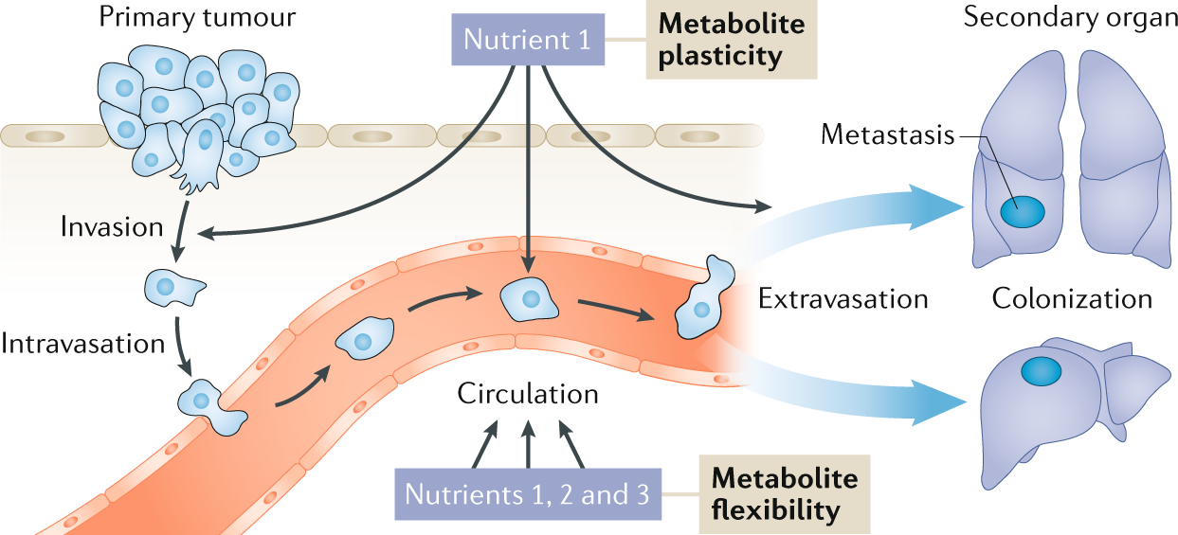
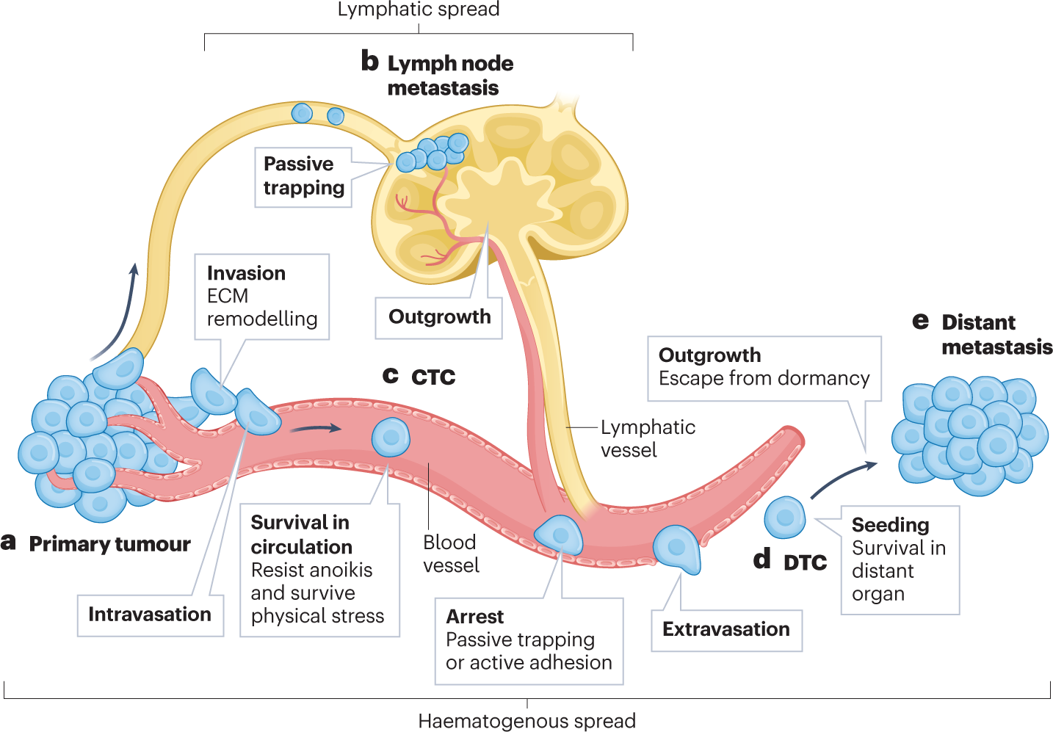
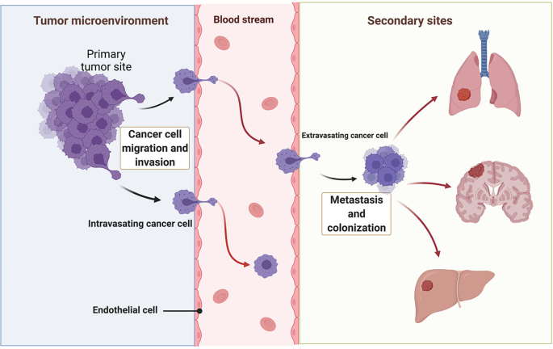

Slide 45
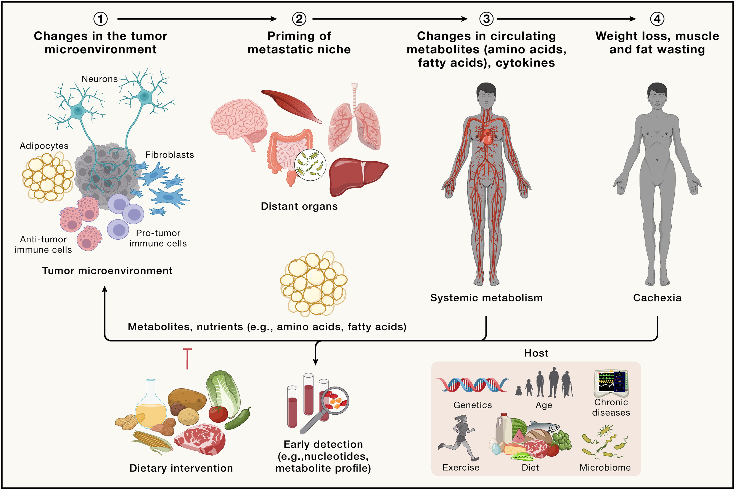
Clinical Effects of Tumours – Local and Systemic
Tumours cause harm through direct local effects on tissues and systemic metabolic disturbance throughout the body.

Slide 46
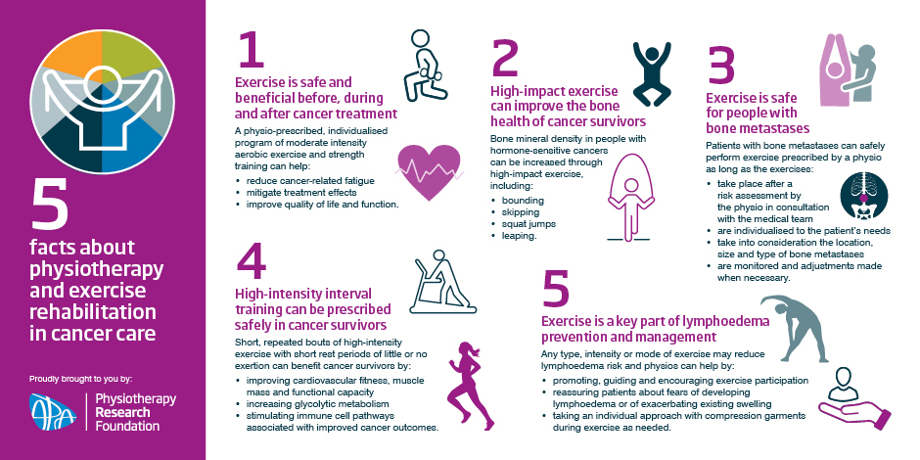
Physiotherapy Implications – Working Safely with Cancer Patients
Physiotherapists play a key role in maintaining mobility, function, and quality of life in cancer care —but understanding pathology and metastasis is critical for safe, evidence-based practice.

Slide 47
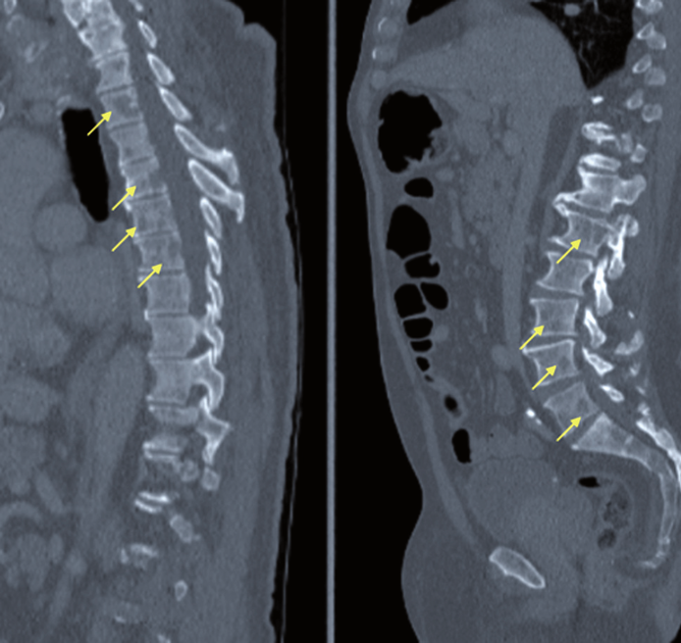
Case Study – Bone Metastasis
Scenario:
A 62-year-old woman with metastatic breast cancer presents with pain in her lower back and right hip. Imaging shows osteolytic lesions in the lumbar spine and right femur.
She has moderate fatigue but is otherwise stable and motivated to remain active.

Slide 48
Discussion Questions
What are your main physiotherapy concerns?
How would you modify her exercise plan?
  What types of movement are safe?
  What should be avoided?
  How to balance mobility and protection?
Which red flags would require you to stop the session and inform the oncology team?

Slide 49
Focus Area | Recommended Approach | Precautions / Rationale
Pain management | Use gentle movement within pain-free range; heat or TENS (if safe) | Avoid aggressive stretching or manual therapy over lesion site
Exercise type | Prioritise low-impact, isometric, and functional training (e.g. sitting to standing, walking aids) | Avoid high-resistance, twisting, or end-range loading
Weight-bearing | Partial or supported weight-bearing if femur/spine involved | Prevent pathological fractures
Fatigue | Incorporate short bouts of exercise with rest breaks | Prevent overexertion and energy depletion
Posture / ergonomics | Educate on safe transfers, correct lifting | Reduce strain on affected bones
Monitoring | Pain scale, mobility tolerance, vital signs | Early detection of deterioration

Slide 50
Prevention & Lifestyle – The Protective Power of Exercise
While some causes of cancer are genetic, up to 40% of cancers are linked to lifestyle factors. Regular physical activity is one of the most powerful preventive tools.
Mechanism | Effect on the Body | Cancer Types with Strong Evidence | Visual Cue
Hormone regulation | Lowers oestrogen and insulin levels | Breast, endometrial | Hormone balance
Improved immune function | Boosts natural killer cells and surveillance | General cancer protection | Stronger defences
Reduced inflammation | Decreases chronic inflammatory cytokines | Colon, liver, pancreas | ↓ Less inflammation
Weight management | Prevents obesity-related metabolic stress | Colon, kidney, oesophagus | Stable weight
Enhanced gut motility | Reduces contact time between toxins and colon wall | Colon | Regular movement

Slide 51

Evidence-Based Impact
30–60 minutes of moderate activity (5× per week) can reduce:
Colon cancer risk by up to 40–50%
Breast cancer risk by up to 30–40%
Endometrial cancer risk by up to 30%
Includes: brisk walking, cycling, dancing, swimming, and resistance training.

Slide 52
From Cell Stress to Cancer Progression: The Pathology Continuum
🟢 Normal Cell
🟡 Stress / Stimulus
🟢 Adaptation
⚠️ Abnormal Cell Growth
Hypertrophy, hyperplasia, atrophy, metaplasia
Dysplasia → Neoplasia
🟠 Reversible Injury
Swelling, fatty change
💥 Malignant Transformation
Benign → Malignant
🔴 Irreversible Injury → Cell Death
Necrosis (uncontrolled) or Apoptosis (programmed)
🩸 Metastasis (Cancer Movement)
Detachment → Invasion → Circulation → Colonisation

Slide 53
Key Takeaways – Cell Death / Growth / Movement
Cell Death | Abnormal Growth | Cancer Movement (Metastasis)
Apoptosis – controlled, tidy, energy-dependent | Hypertrophy / Hyperplasia – adaptive growth | Detachment – loss of adhesion (↓ E-cadherin)
Necrosis – uncontrolled, inflammatory | Metaplasia – reversible change of cell type | Invasion – enzyme-mediated tissue breakdown
Autophagy – recycling for survival | Dysplasia → Neoplasia – disordered & autonomous growth | Intravasation – entry into blood/lymph
Reversible vs Irreversible injurydetermines recovery | Benign vs Malignant: benign = localised; malignant = invasive | Circulation & Extravasation – survival and exit at new site
Physio link: tissue recovery depends on degree of injury | Molecular control: oncogenes (gas) vs tumour suppressors (brakes) | Colonisation: secondary tumour forms → systemic disease
Apoptosis = good stress adaptation Necrosis = damage to avoid | Adaptation can become pathology if stress persists | Metastasis = key cause of cancer mortality

Slide 54

Quiz Time – Test Your Knowledge
Which of the following best describes apoptosis?
A. Uncontrolled cell death causing inflammation
B. Controlled, energy-dependent programmed cell death
C. Necrosis of multiple tissues
D. Accidental rupture of the plasma membrane

Slide 55

A muscle cell deprived of oxygen that swells but recovers after reperfusion has experienced:
A. Necrosis
B. Apoptosis
C. Reversible injury
D. Dysplasia

Slide 56

Which of the following represents an adaptive cellular response to stress?
A. Necrosis
B. Hypertrophy
C. Metastasis
D. Karyolysis

Slide 57

What key feature distinguishes neoplasia from hyperplasia?
A. Neoplasia depends on growth factors
B. Neoplasia is reversible
C. Neoplasia continues even after stimulus removal
D. Neoplasia occurs only in connective tissue

Slide 58

The tumour suppressor gene p53 functions primarily to:
A. Stimulate angiogenesis
B. Promote apoptosis after DNA damage
C. Repair extracellular matrix
D. Activate telomerase

Slide 59

During metastasis, E-cadherin loss leads to:
A. Increased adhesion between tumour cells
B. Enhanced cell-to-cell communication
C. Detachment and increased invasiveness
D. Cell death via apoptosis

Slide 60

In physiotherapy, which of the following is the most important precaution when working with a patient with bone metastases?
A. Encourage resistance training for bone strength
B. Apply heat therapy to the affected site
C. Avoid high-load or impact exercises
D. Perform spinal mobilisation for pain relief

Slide 61


